Slide 1
reference report

Slide 2
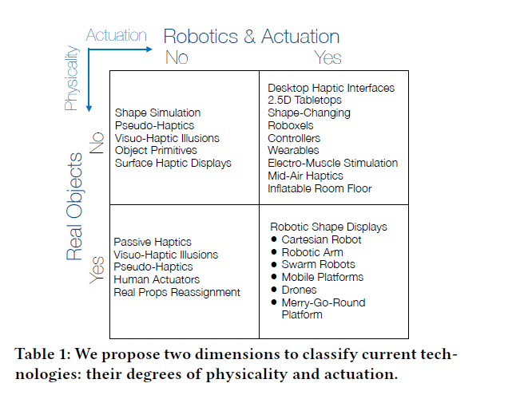
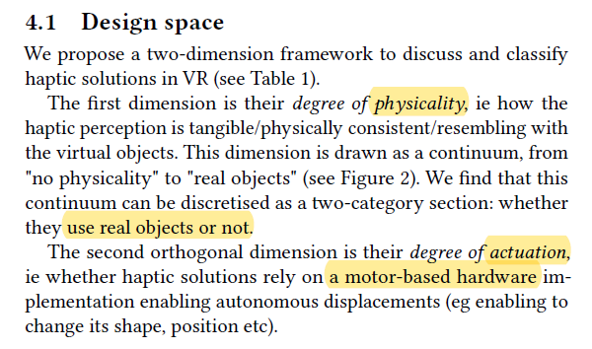
PA model
> “Can I Touch This?”: Survey of Virtual Reality Interactions via Haptic Solutions

Slide 3
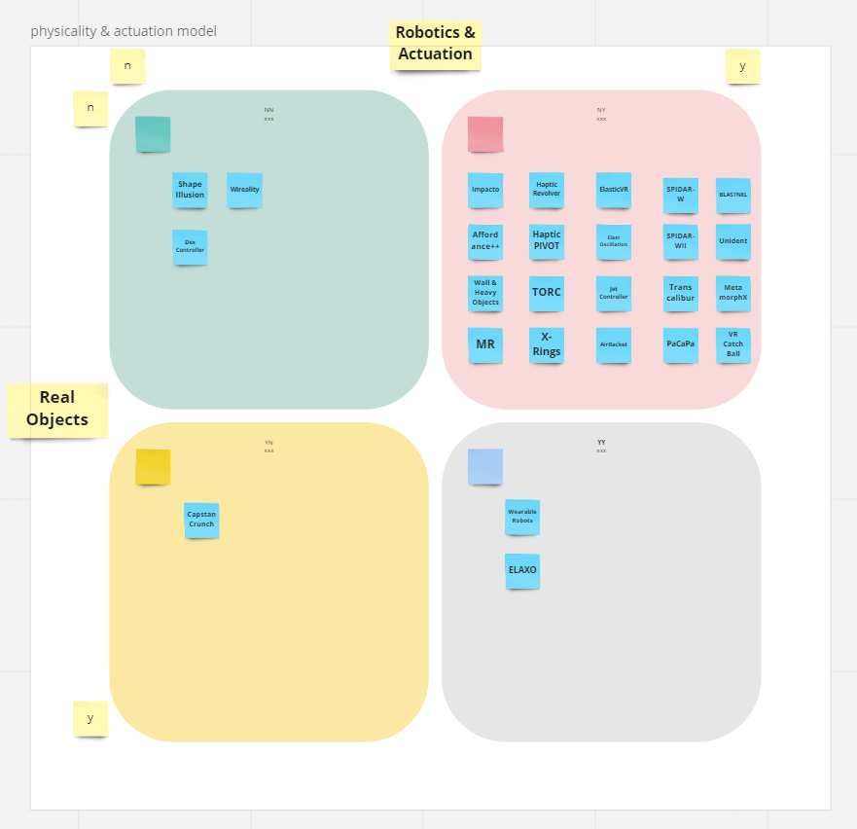
catalog by PA model

Slide 4
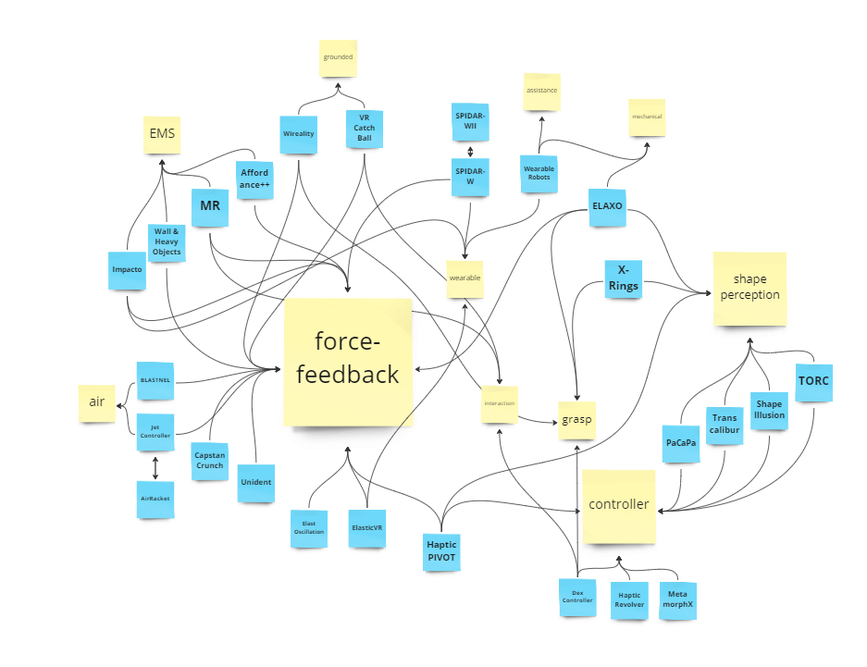
catalog by keywords
criteria：
keyword
abstract & introduction
compared to others
*Not classified to the category when it is not mentioned the concept.

Slide 5
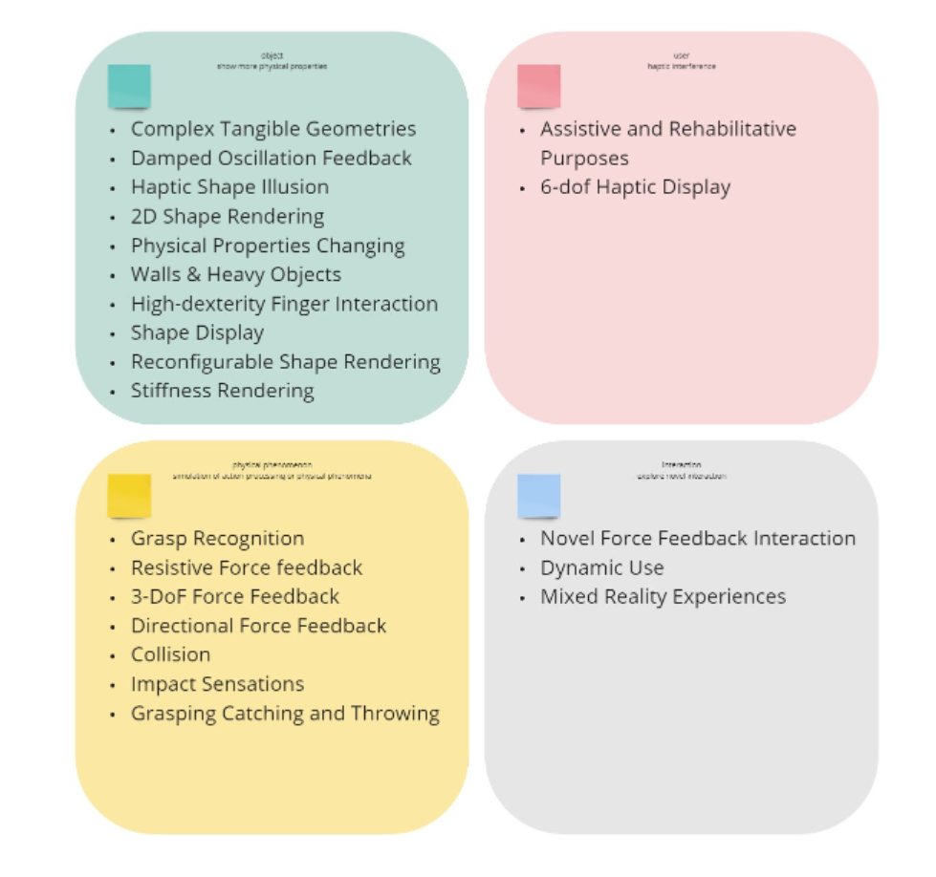
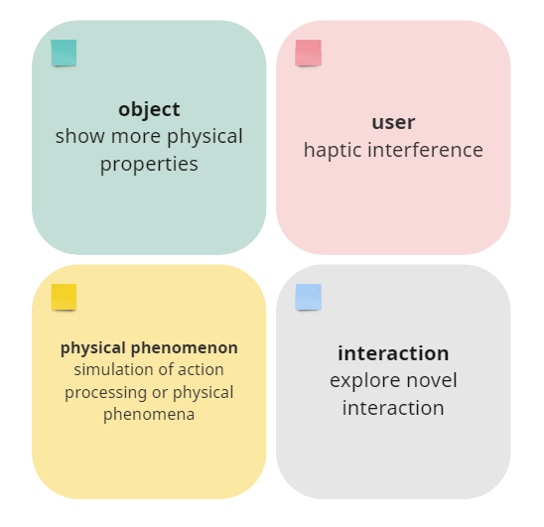
catalog by research object

Slide 6
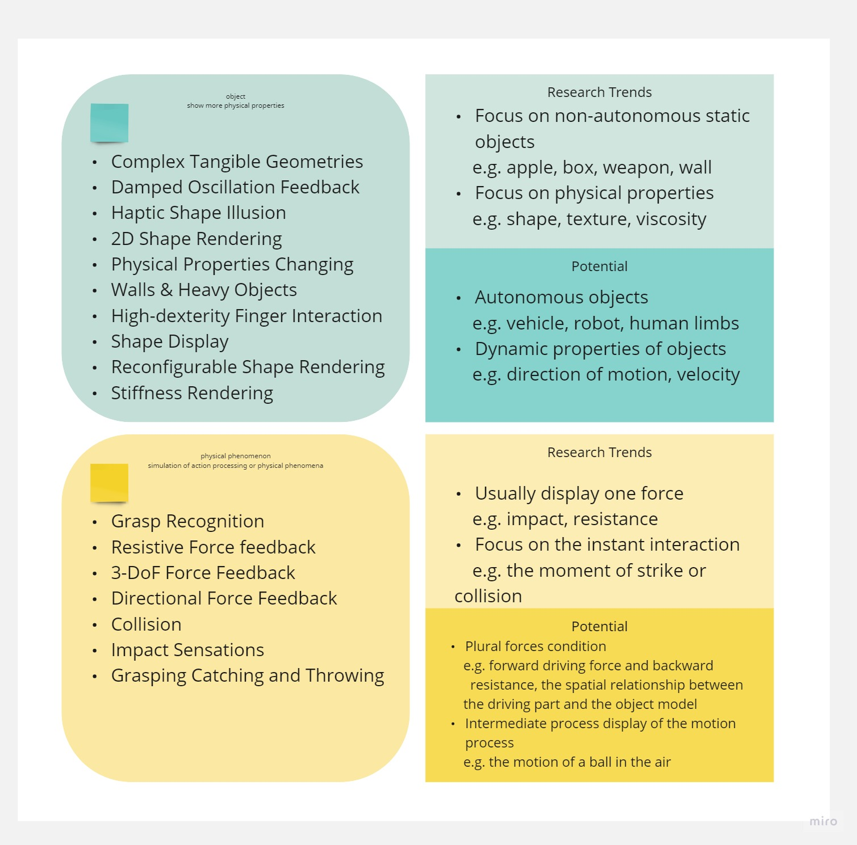
research trends

Slide 7
study case

Slide 8
motion state
no specific definition of motion
avatar target：limb movement, sports movement, actio haptic
object target：motion state, movement haptic
synonym：movement, action, sports,motion state, 6 dof haptic display
potential functions: displacement,navigation,locamotion

Slide 9
human walking in VRE

Slide 10
motion track wearable haptic device

Slide 11
abstract report

Slide 12
A continuous motion feedback controller
A controller that can continuously feedback the motion state of dynamic objects under VR environment
Notes:
motion state help user manipulate

Slide 13
research question
Inconsistency of vistual feedback and real hand motion.
--A Survey on Simulation for Weight Perception in Virtual Reality
How to show the movement/motion state by haptic?
Why? Because objects in VR space are constrained by the map design and the physics engine, but the user has no any reference or limitations in the VR activity area of reality.

Slide 14
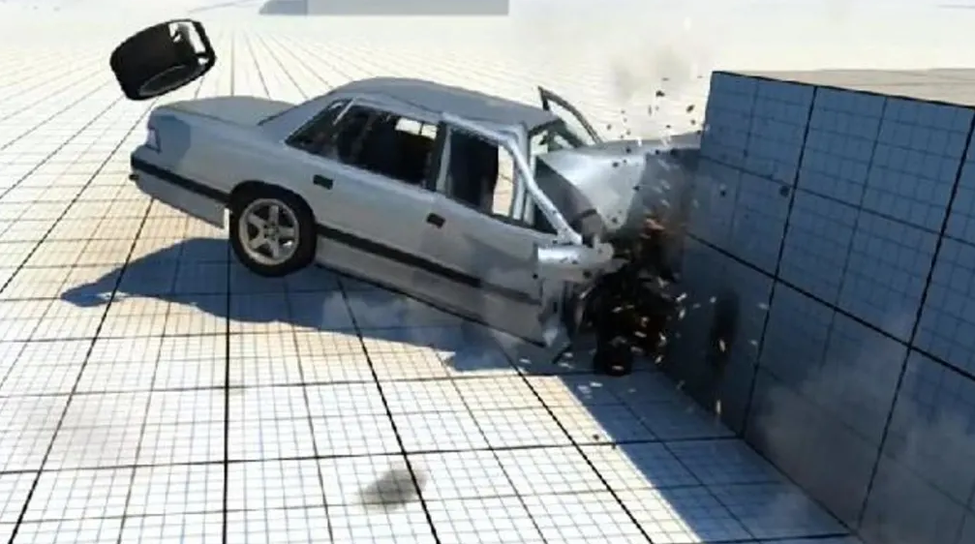
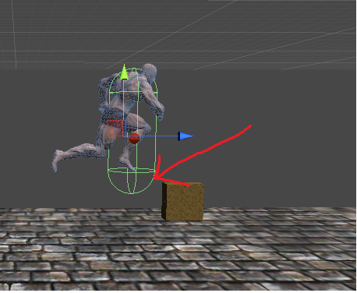
example
For example, when the avatar encounters an obstacle, the current VR visual only can show the character is unable to move forward, and according to most studies will only have resistance force or vibration to provide interaction. But the ideal effect is that the user should feel the forward force of the character and the resistance of the obstacle, more specifically, the driving force of the legs and the resistance from the touch point.

Slide 15
purpose
This project is designed to reveal the motion state of the object or avatar under the VR environment, and give feedback to the user, in order to enhance the user's ability to manipulate the object so that the user is more aware of the interaction with the currently manipulated thing.
The motion state is the overall motion state of the object, and is not limited to a single force situation, or it can also represent the motion state of a small part.
Through such motion state feedback, aim to enhance the user's operation under the VR environment, can help user understand the current object's motion state, enhance the synchronization rate and connection between the user and the manipulated object, enhance the VR immersion. Can also be applied with telexistence. Make the robot easier to operate, and help operater quickly understand the movement state of various parts of the robot.

Slide 16
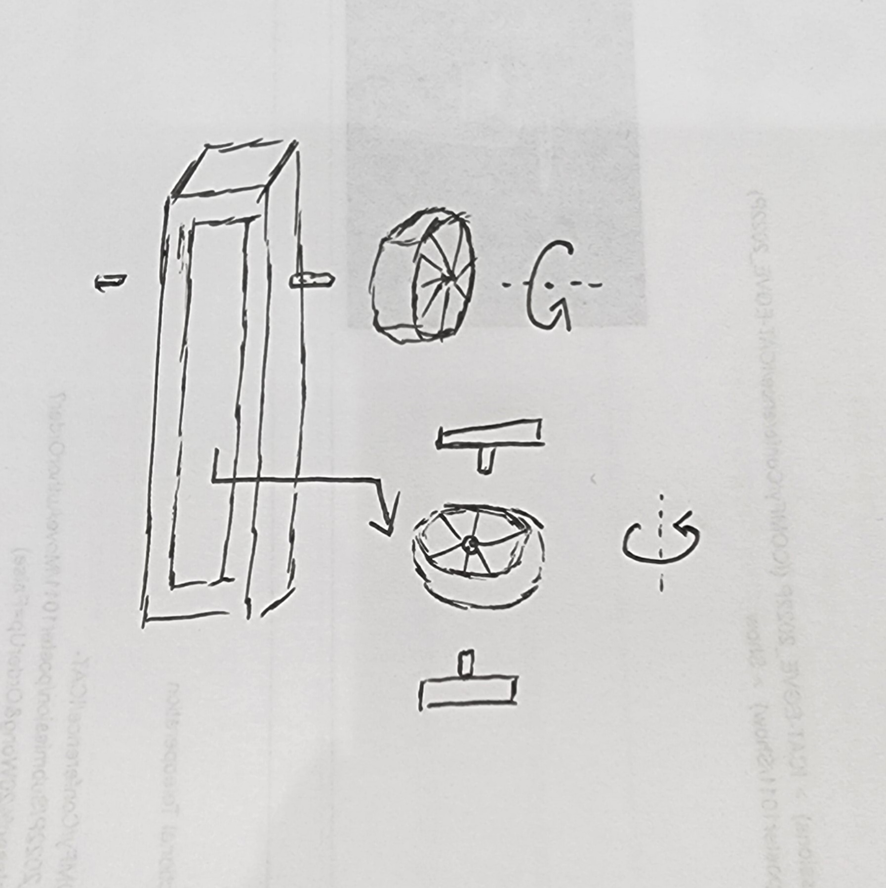
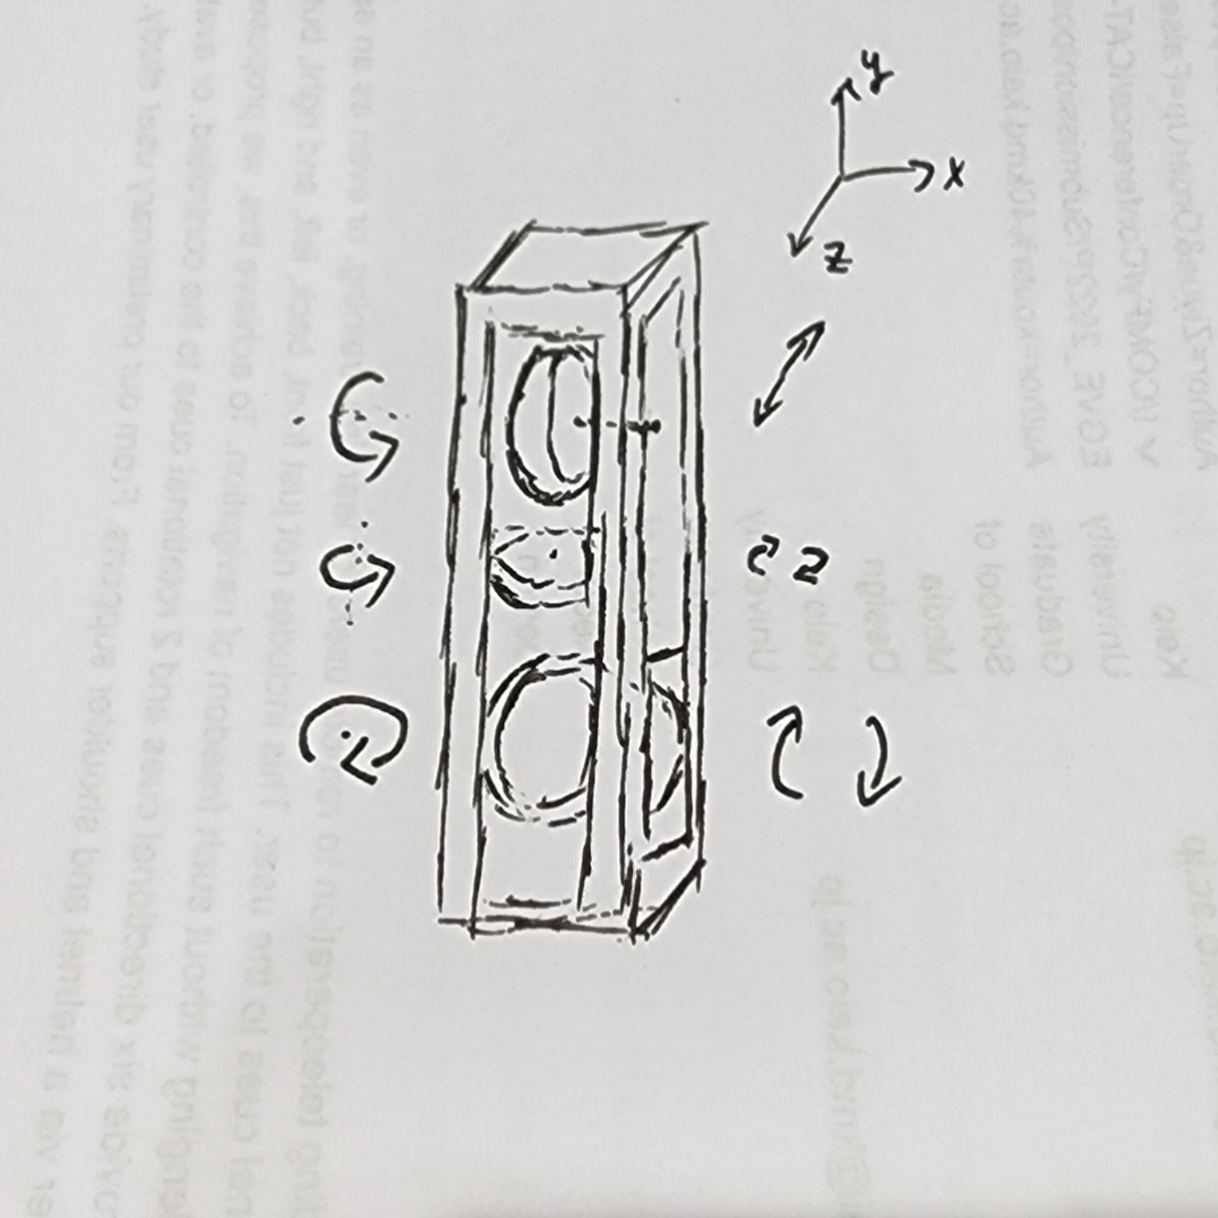
methods-1
Handheld controller, set some belt-winding wheel structure in the center part, and the user can feel the motion state of the object by touching these wheels by hand,the goal is to set 3 wheels to achieve 3dof feedback including front and back, left and right, up and down.
Notes:
design from seniror

Slide 17
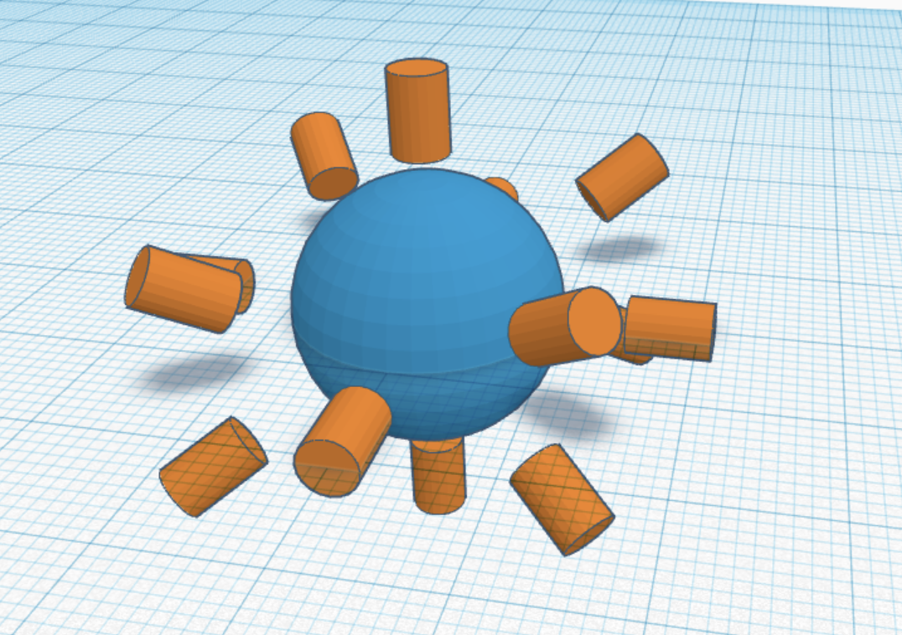
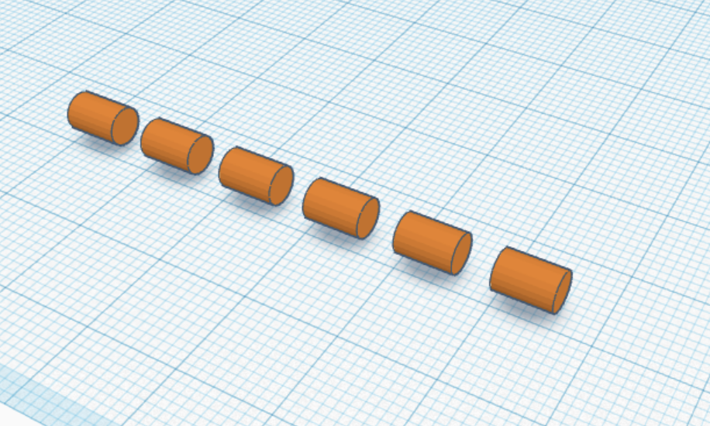
methods-2
A large number of haptic motor are used in superposition, and the full range of feedback or series structure can simulate the whole process of linear motion.

Slide 18
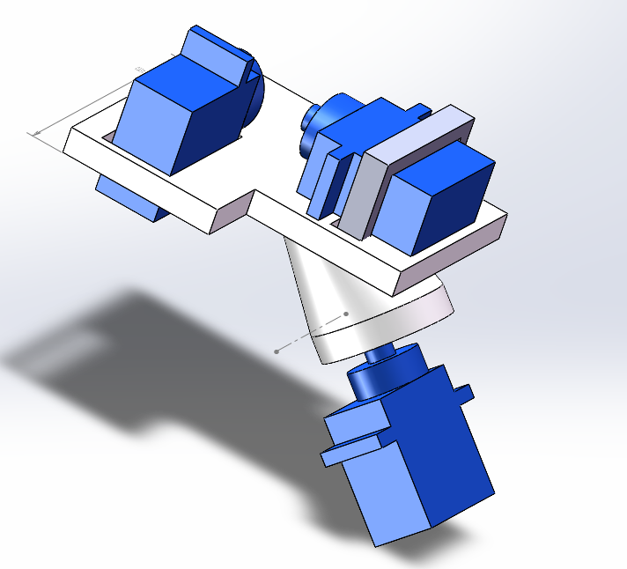
prototype

Slide 19
之前文章不足的地方
有对旋转度的误差，和运动状态持续的研究，但是缺乏对精确位移度的研究，之前的轨道式位移表现受限于
根据多个应用案例，注重于平面驾驶的研究，但是对于在高度轴（UP and Down）上的位移变量以及左右倾斜(Roll)等数据没有研究
6dof的硬件设备上，仍然使用倾斜方式，能否在同一设备中使用旋转装置同时表示旋转和位移向量。
改进计划，通过两个旋转装置的组合是否可以表示多个方向上的运动变化

Slide 20
application_TODO
dynamic object, such as vr driving
avatar, such as the character
a part of the avatar, such as arm or handheld object
a physical thing, such as toto
a part of a physical thing, such as robotic arm
Notes:
Maeda:
1. The survey needs to be more professional
2. What kind of scenarios the motion state info is more beneficial to the user
3. Whether motion state display can really help users to manipulate objects more quickly and easily - research objective
4. How to pass the motion state to user ? design
5. The design needs to take into account that different parts of hand require different haptic solutions
6. The entire research needs to base on the scenario
7. Try to answer these questions - https://iis-lab.org/misc/realitycheck/

